Slide 1



UNICORN COMPANIES
PRESENTED BY MANISH K

Slide 2

INTRODUCTION
The unicorn startup ecosystem is a fascinating area of study, offering insights into the dynamics of high-growth companies valued at over $1 billion. This project aims to analyze a dataset containing information about unicorn companies, including their valuation, date joined, country, and industry. By leveraging SQL queries, we can uncover trends and patterns that define these successful startups.

Slide 3
OBJECTIVE
The primary objective of this project is to analyze the unicorn companies dataset to answer key questions about the distribution, valuation, and growth of these companies. Specifically, we aim to:
Identify the industries with the highest number of unicorn companies.
Examine the geographic distribution of unicorn companies across different countries.
Determine the average valuation of unicorn companies within each industry.
Analyze the founding trends of unicorn companies over the years.
Calculate the ages of the companies to understand their longevity.
Calculate the age of a company in that industry
Total valuation of the company by country

Slide 4
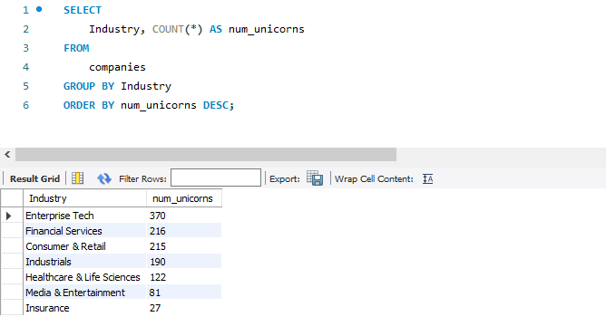


Q1. Which industries have the highest number of unicorn companies?

Slide 5
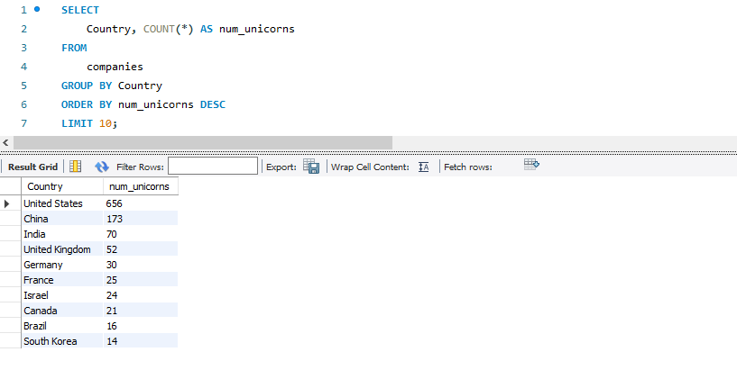
Q2.How are unicorn companies distributed across different countries?

Slide 6
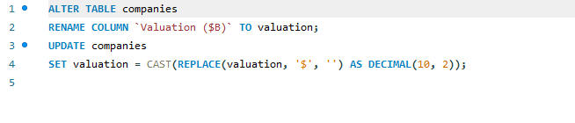
Changing the Name of the column and formatting it

Slide 7
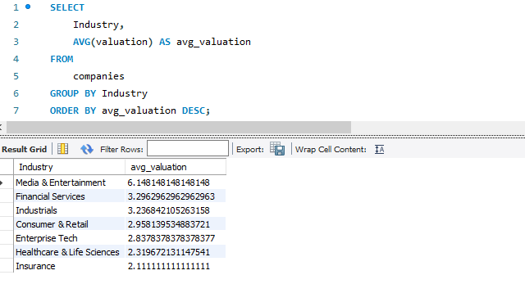
Q3. What is the average valuation of unicorn companies in each industry?

Slide 8
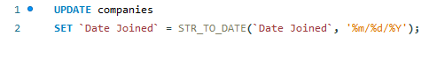
Formatting the Date Column

Slide 9
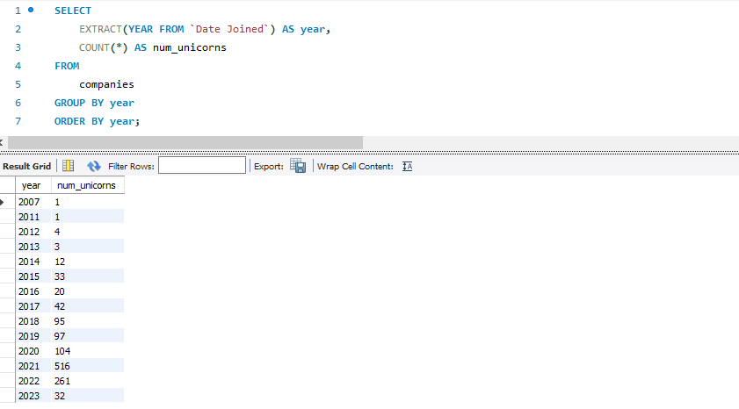
Q4. How many unicorn companies were founded each year?

Slide 10
Q5. What are the ages of the Companies?

Slide 11
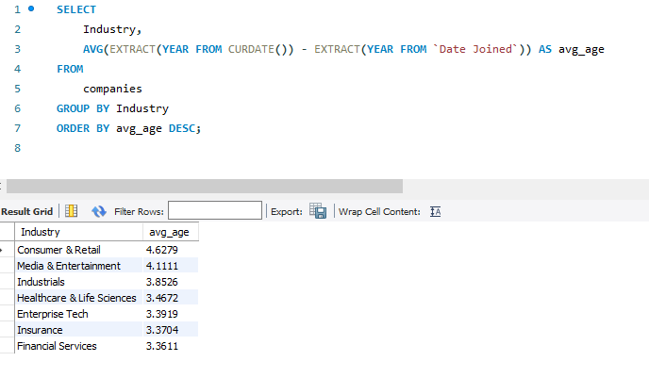
Q6. Average Age of Companies by Industry

Slide 12
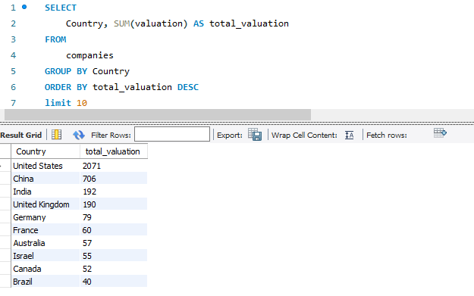
Q7. Total Valuation by Country in Billion

Slide 13
CONCLUSION
This project provides a comprehensive analysis of unicorn companies, uncovering key trends and patterns in their distribution, valuation, and growth. By answering critical questions through SQL queries, we gain valuable insights into the dynamics of high-growth startups. These findings can inform investors, entrepreneurs, and policymakers about the factors contributing to the success of unicorn companies and the sectors and regions leading this growth.

